Slide 1
Progress presentation
Quantum Circuit Born Machine and
SQA hyperparameter tuning using Bayesian Optimization, using myQLM
César Hernando
Quantum Engineer Intern
30/07/2025

Slide 2
1
Results review of QSVM
2
Quantum Circuit Born Machine (QCBM)
3
Bayesian Optimization applied to SQA

Slide 3
1
Results review of QSVM

Slide 4
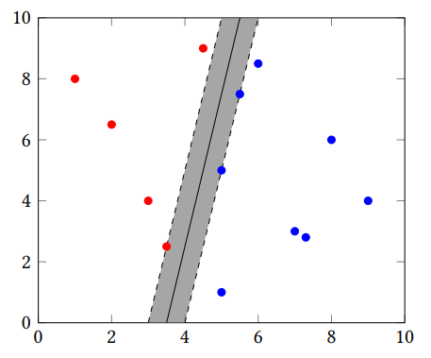
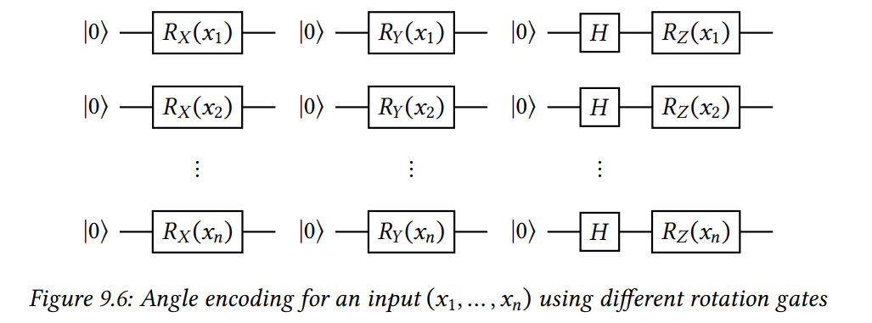
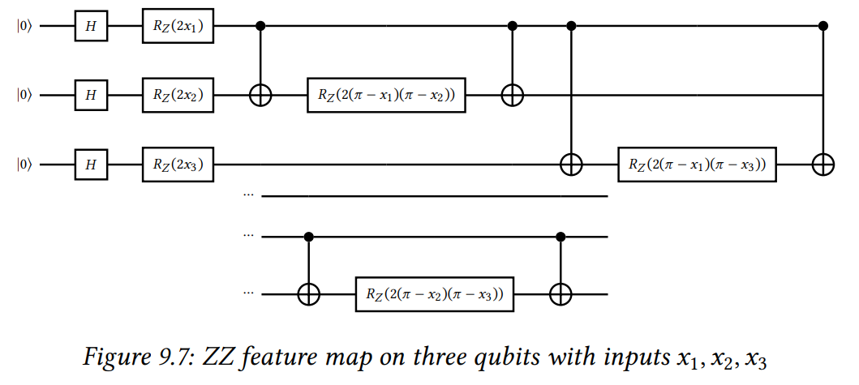
Results review of QSVM
In the QSVM implementation, two types of feature maps were used.
Angle encoding is shallower and consequently, computationally less expensive.
ZZ Feature map entangles the qubits, and has more expressivity.
Angle encoding
ZZ Feature map

Slide 5
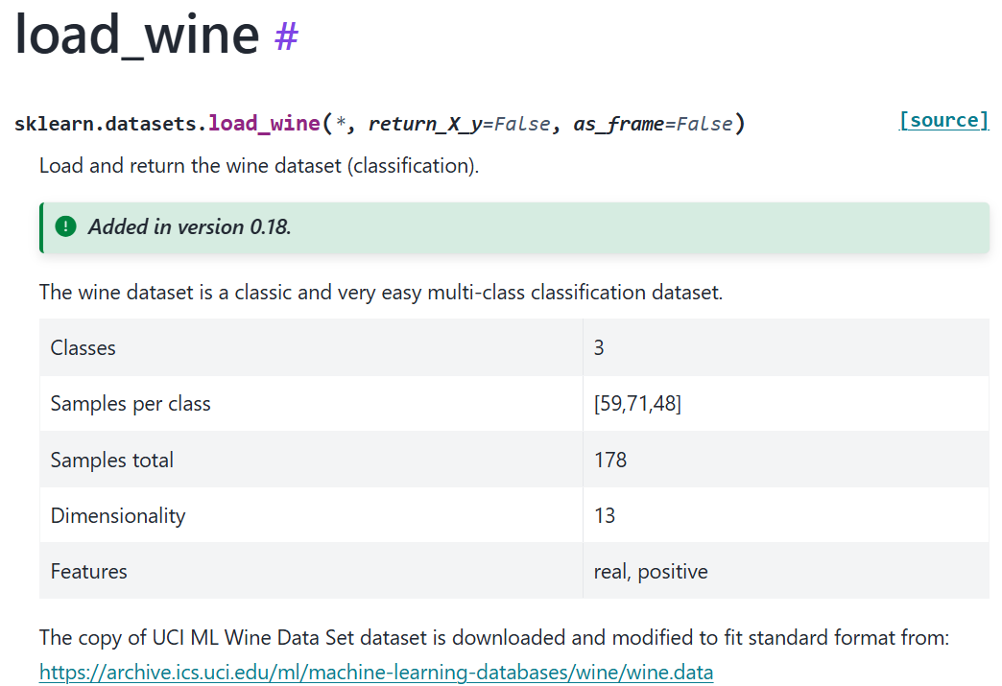
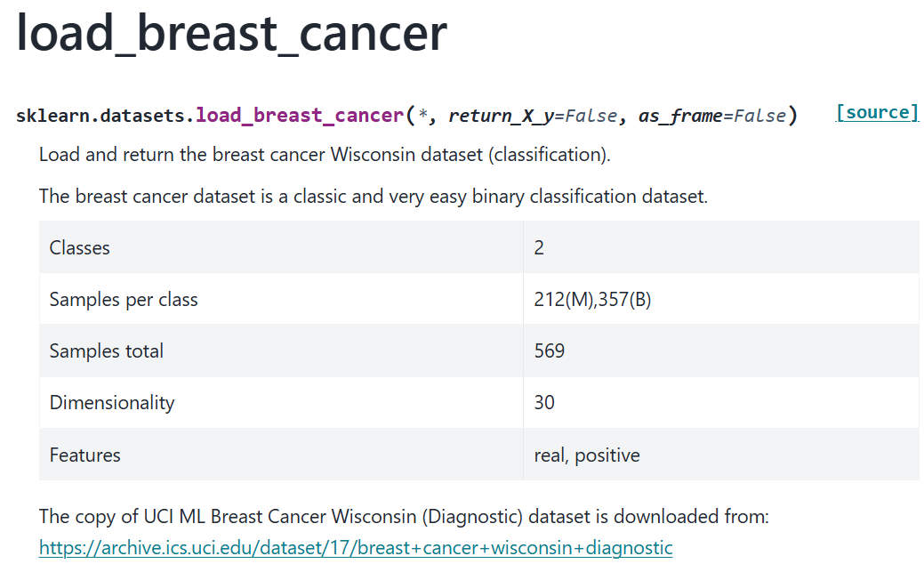
Results review of QSVM
In addition to the previously wine classification dataset, a more complex but still tractable dataset was utilized

Slide 6
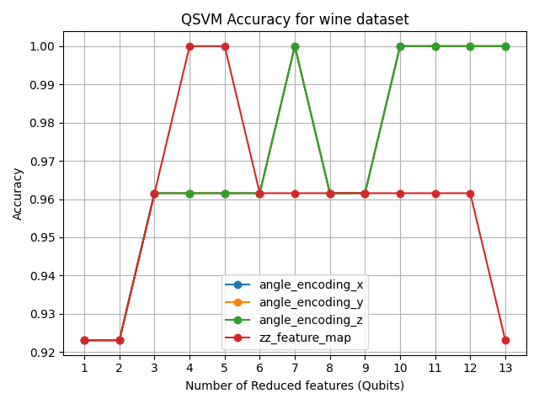
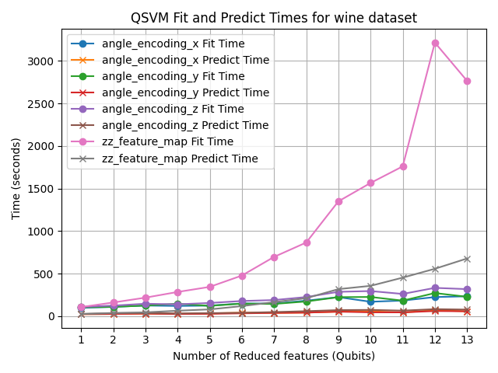
Results review of QSVM
Wine dataset

Slide 7
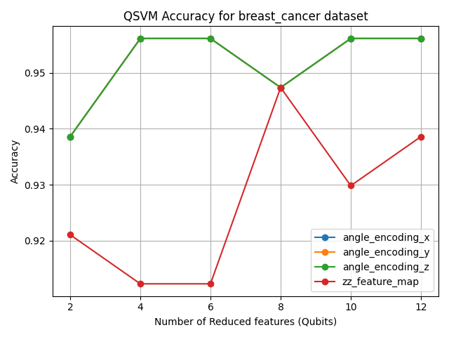
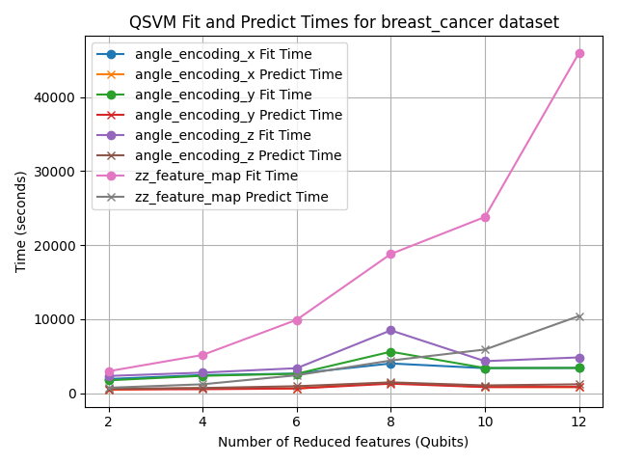
Results review of QSVM
Breast cancer dataset

Slide 8
Results review of QSVM
Conclusions
Angle encoding achieves a higher accuracy and has a better computational time scaling compared to ZZ feature map
The rotation axis is irrelevant in terms of accuracy, but the rotation around Z has a higher computational cost due to the Hadamard gates
Both datasets show a non-monotous dependence with the number of PCA-reduced features
QSVM learns to predict the corresponding label with high accuracy for both datasets

Slide 9
Results review of QSVM
Deliverables
A QSVM class, which is agnostic to the dataset (myqml.py)
A Jupyter notebook with the documentation of the class (qsvm_documentation.ipynb)
A Jupyter notebook tutorial explaining the QSVM algorithm and implementing it for both datasets (example_qsvm.py)
An analysis file which varies the feature map and the PCA-reduced number of features (analysis_qsvm.py) and a file to plot the results (plot_qsvm.py)
Link of github repository: https://github.com/cesar-hernando/QML

Slide 10
Questions?

Slide 11
In the last presentation…
Some QML algorithms that could be added:
Quantum Support Vector Machine (QSVM)
Quantum Neural Networks / Parametrized Quantum Circuits (QNNs/PQCs)
Quantum Convolutional Neural Networks (QCNNs)
Quantum Circuit Born Machine (QCBM)
Quantum Generative Adversarial Networks (QGANs)
Quantum reinforcement learning
Supervised Learning
Unsupervised Learning
Reinforcement Learning

Slide 12
2
Quantum Circuit Born Machine

Slide 13
2.1
Introduction to unsupervised generative learning
2.2
Quantum Circuit Born Machine (QCBM): Algorithm and implementation in myQLM
2.3
Results for a toy dataset of Bars and Stripes

Slide 14
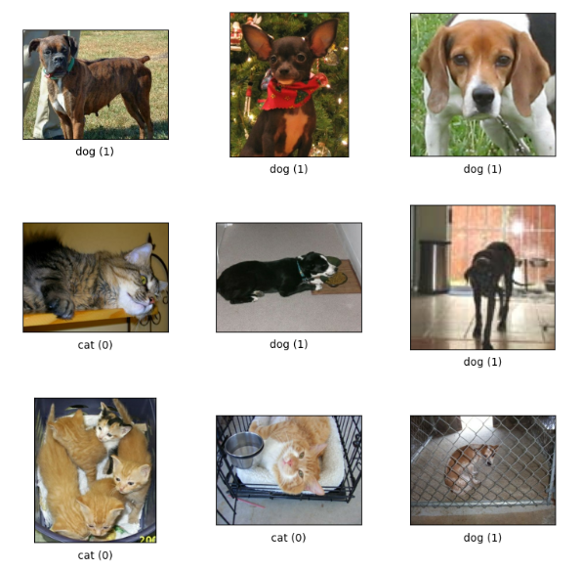
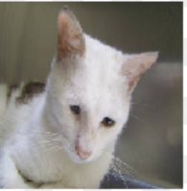
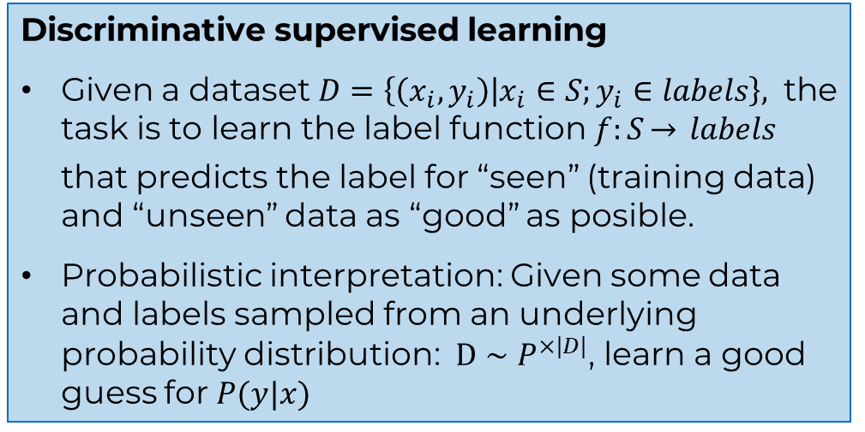
1. Introduction to Unsupervised generative learning
Discriminative supervised learning
Given a dataset $D=\left\{\left(x_{i},y_{i}\right) | x_{i}∈S;y_{i}∈labels\right\},$ the task is to learn the label function $f:S\overset{→}{} labels$ that predicts the label for “seen” (training data) and “unseen” data as “good” as posible.
Probabilistic interpretation: Given some data and labels sampled from an underlying probability distribution: $D∼P^{×|D|}$, learn a good guess for $P(y|x)$
Cat or dog?

Slide 15
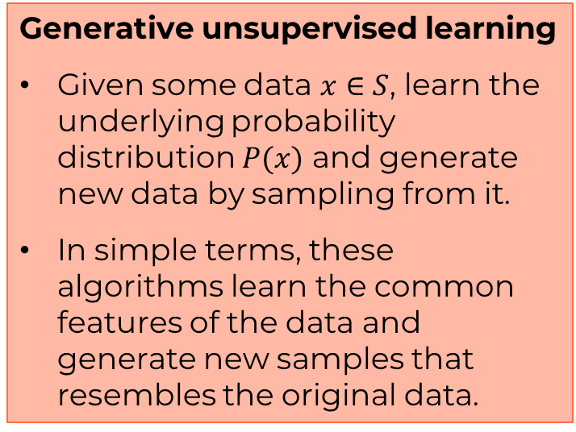
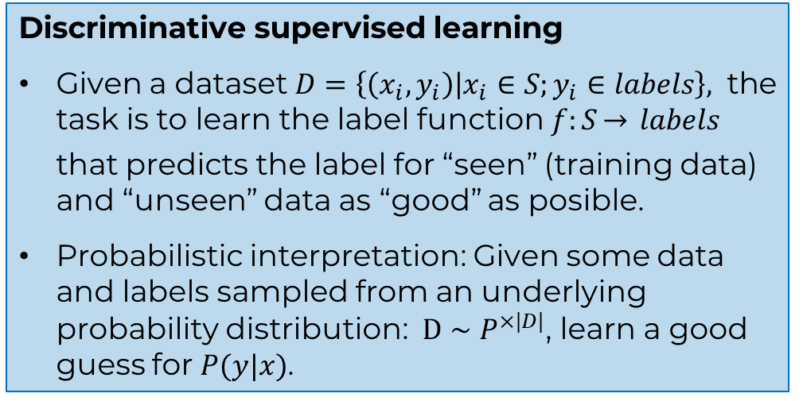
1. Introduction to Unsupervised generative learning
Discriminative supervised learning
Given a dataset $D=\left\{\left(x_{i},y_{i}\right) | x_{i}∈S;y_{i}∈labels\right\},$ the task is to learn the label function $f:S\overset{→}{} labels$ that predicts the label for “seen” (training data) and “unseen” data as “good” as posible.
Probabilistic interpretation: Given some data and labels sampled from an underlying probability distribution: $D∼P^{×|D|}$, learn a good guess for $P(y|x)$.
Generative unsupervised learning
Given some data $x∈S$, learn the underlying probability distribution $P(x)$ and generate new data by sampling from it.
In simple terms, these algorithms learn the common features of the data and generate new samples that resembles the original data.
There are also discriminative unsupervised algorithms (clustering, e.g. K-means, DBSCAN) and other types of unsupervised algorithms (dimensionality reduction/data compression, e.g. PCA, Autoencoder NN)

Slide 16
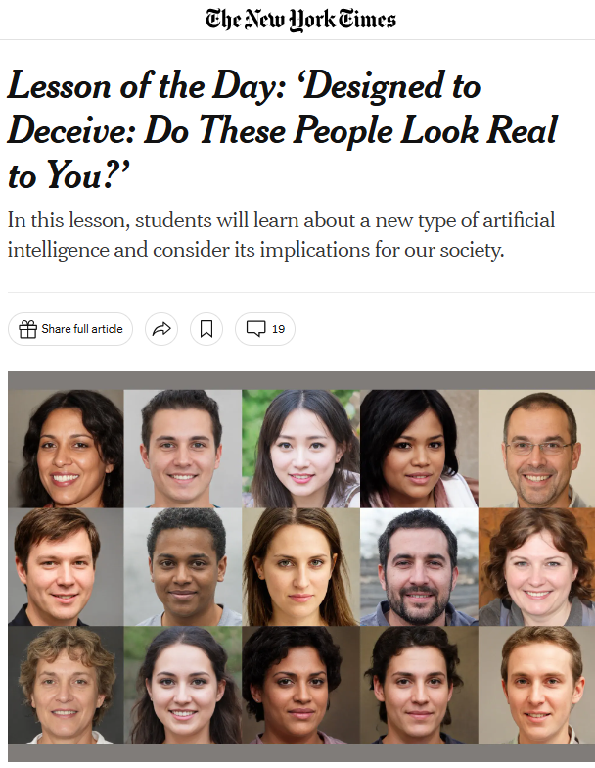
1. Introduction to Unsupervised generative learning
Examples of applications
Given a dataset of cats. Generate new cats
Generate fake pictures of people
Drug discovery by generating new molecular structures
Most important classical ML algorithms
Variational Autoencoders (VAE)
Generative Adversarial Networks (GANs)
Diffusion models
Restricted Boltzmann Machine

Slide 17
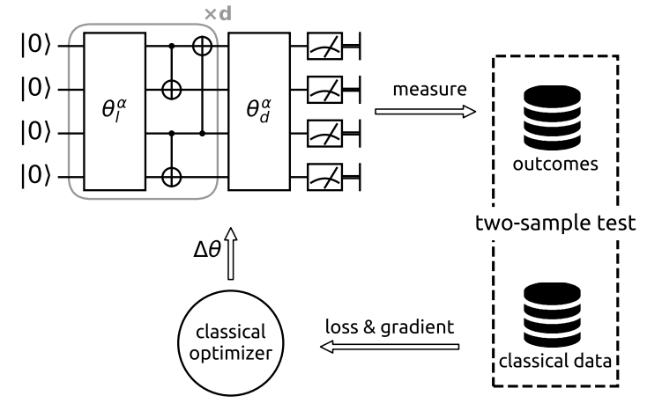
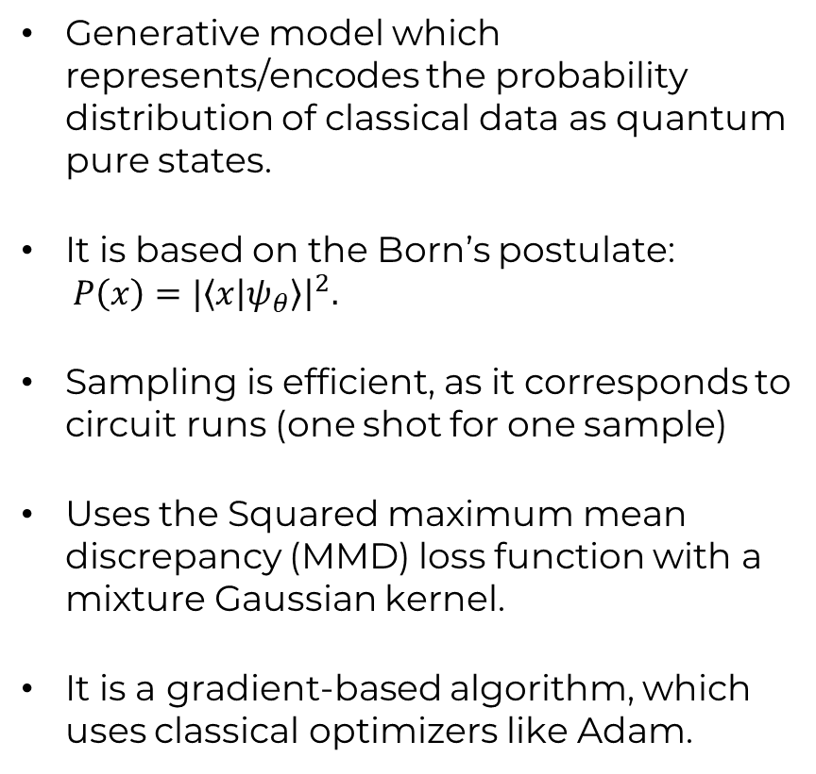
2. Quantum circuit Born machine: Overview
Generative model which represents/encodes the probability distribution of classical data as quantum pure states.
It is based on the Born’s postulate: $P\left(x\right)=|\left\langle x | ψ_{θ}\right\rangle {\left.​\right|}^{2}.$
Sampling is efficient, as it corresponds to circuit runs (one shot for one sample)
Uses the Squared maximum mean discrepancy (MMD) loss function with a mixture Gaussian kernel.
It is a gradient-based algorithm, which uses classical optimizers like Adam.
Benedetti, M., Realpe-Gómez et al (2018). A generative modeling approach for benchmarking and training shallow quantum circuits. Physical Review A, https://doi.org/10.1103/PhysRevA.98.062324

Slide 18
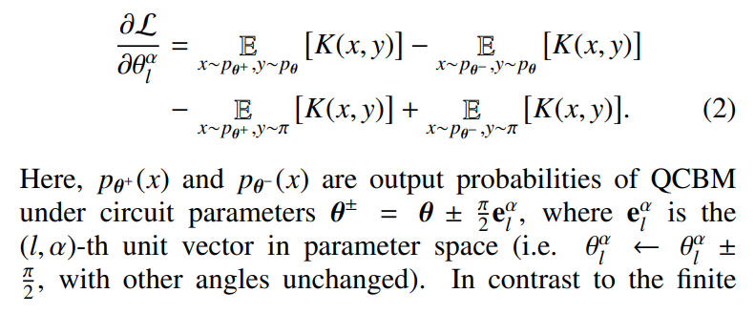
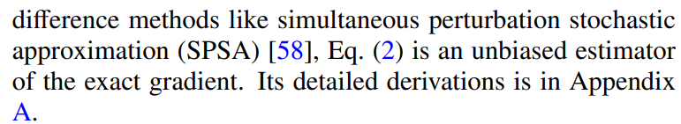
2. Quantum circuit Born machine: Technical details
In the same spirit as in in Supervised QNN, where parametrized quantum circuits (with rotation gates) are used, the gradient of the loss function with respect to the los function can be calculated using the Parameter Shift Rule:
Using this gradient, I implemented two possible optimizers:
Adam
L-BFGS-B (in scipy)
Benedetti, M., Realpe-Gómez et al (2018). A generative modeling approach for benchmarking and training shallow quantum circuits. Physical Review A, https://doi.org/10.1103/PhysRevA.98.062324

Slide 19
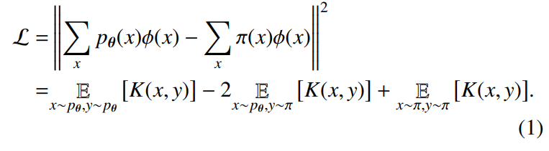
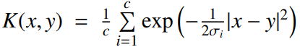
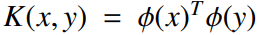
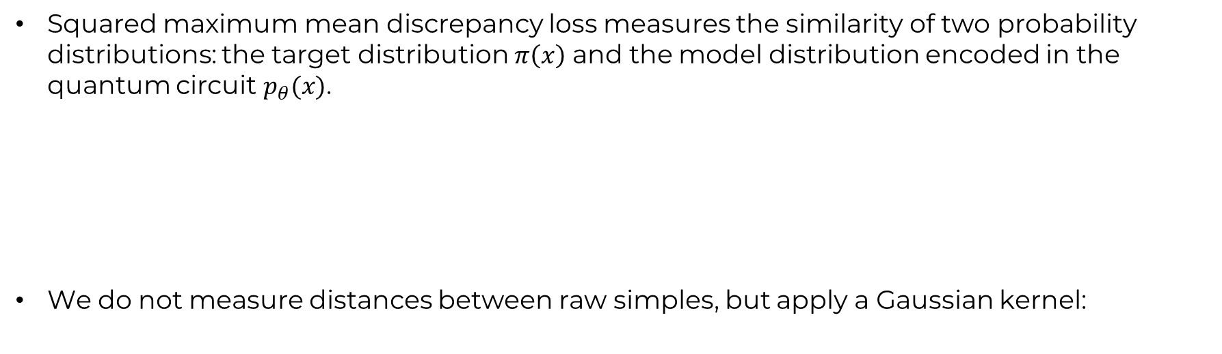
2. Quantum circuit Born machine: Technical details
Squared maximum mean discrepancy loss measures the similarity of two probability distributions: the target distribution $π\left(x\right)$ and the model distribution encoded in the quantum circuit $p_{θ}(x)$.
We do not measure distances between raw simples, but apply a Gaussian kernel:
Benedetti, M., Realpe-Gómez et al (2018). A generative modeling approach for benchmarking and training shallow quantum circuits. Physical Review A, https://doi.org/10.1103/PhysRevA.98.062324

Slide 20
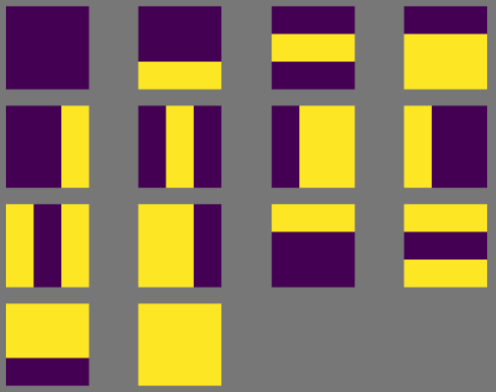
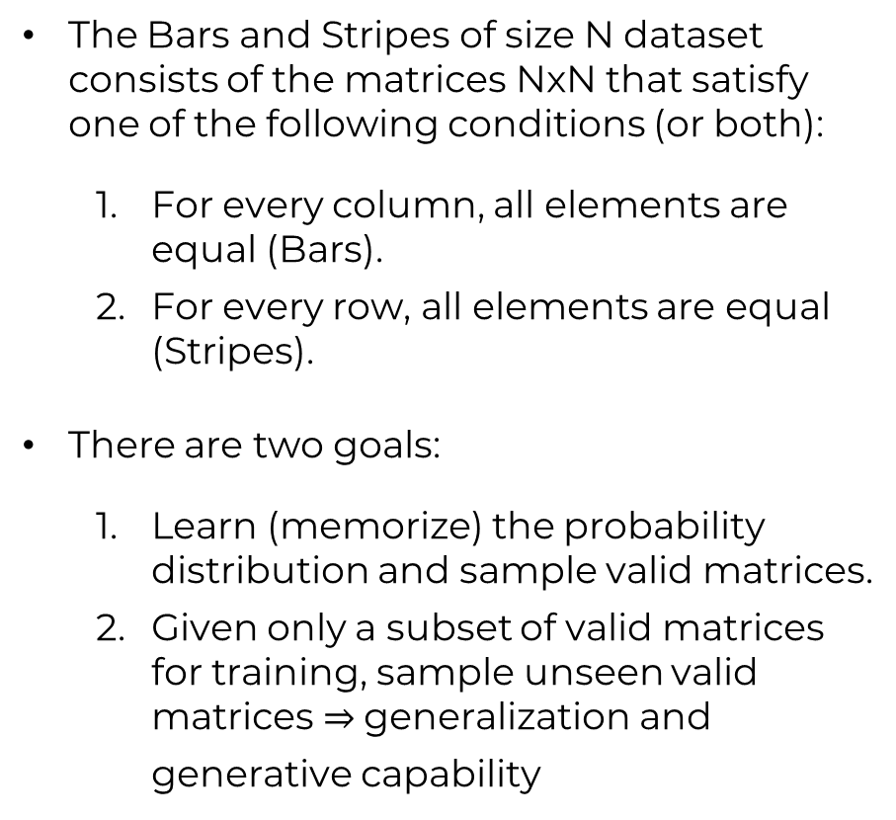
3. Bars and Stripes dataset
The Bars and Stripes of size N dataset consists of the matrices NxN that satisfy one of the following conditions (or both):
For every column, all elements are equal (Bars).
For every row, all elements are equal (Stripes).
There are two goals:
Learn (memorize) the probability distribution and sample valid matrices.
Given only a subset of valid matrices for training, sample unseen valid matrices generalization and generative capability
Benedetti, M., Realpe-Gómez et al (2018). A generative modeling approach for benchmarking and training shallow quantum circuits. Physical Review A, https://doi.org/10.1103/PhysRevA.98.062324

Slide 21
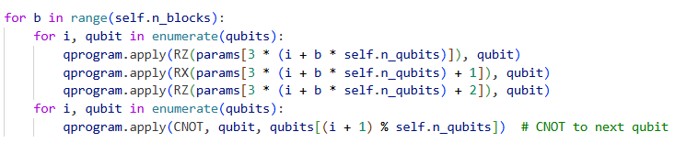
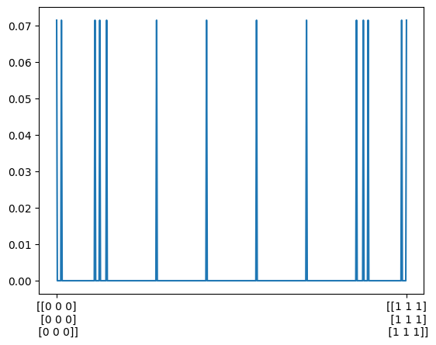
4. Results: Memorization
Anstatz
9 qubits
10 blocks
20000 shots
sigma_list_kernel = [0.5, 1, 2, 4]
Adam optimizar (learning rate = 0.1)
We use all the valid matrices for training
10000 generated samples
Target distribution

Slide 22
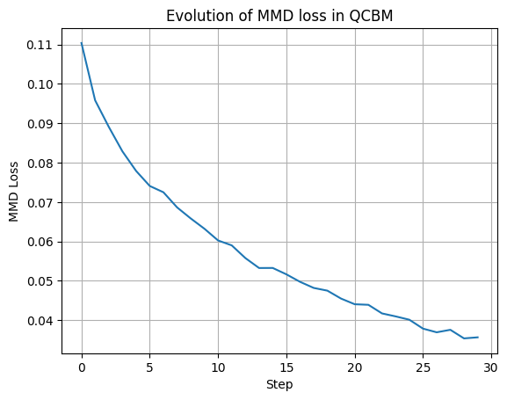
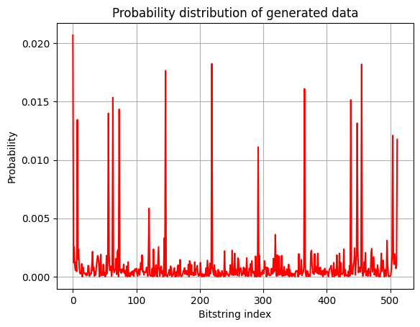
4. Results: Memorization

Slide 23
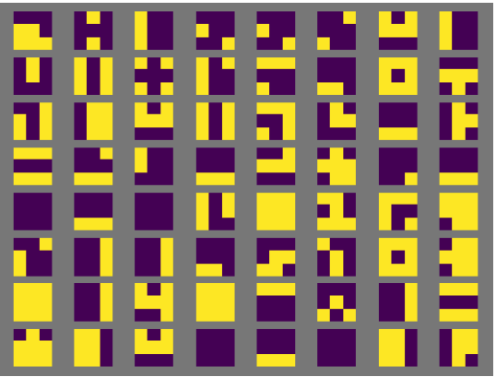
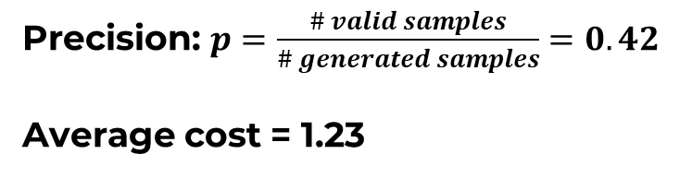
4. Results: Memorization
64 first generated samples
Precision: $p=\frac{\# valid samples}{\# generated samples}=0.42$
Average cost = 1.23
The cost measures how off a sample is from being a Bar or a Stripe,i.e. how many pixels we would have to change to get a Bar or Stripe

Slide 24
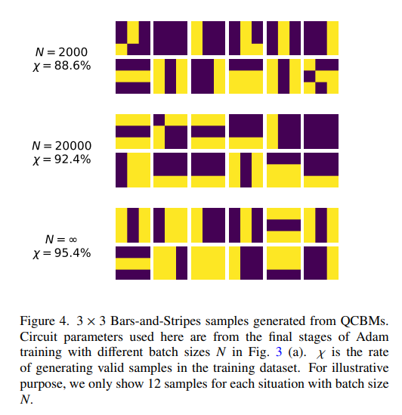
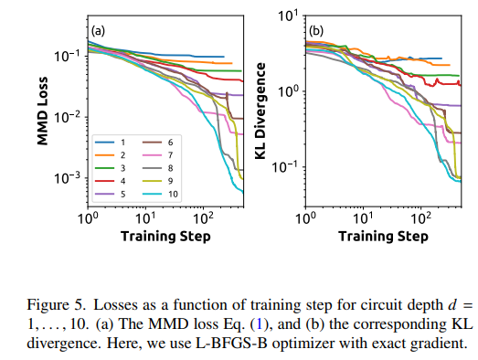
4. Results: Memorization
Comparison to paper:
Benedetti, M., Realpe-Gómez et al (2018). A generative modeling approach for benchmarking and training shallow quantum circuits. Physical Review A, https://doi.org/10.1103/PhysRevA.98.062324

Slide 25
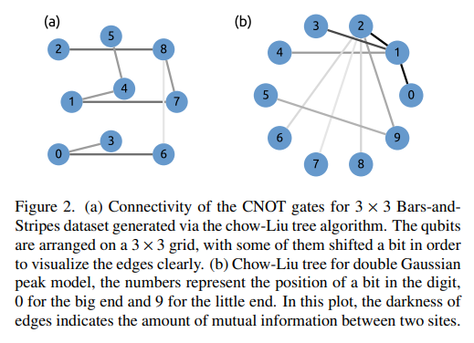
4. Results: Memorization
Comparison to paper:
Benedetti, M., Realpe-Gómez et al (2018). A generative modeling approach for benchmarking and training shallow quantum circuits. Physical Review A, https://doi.org/10.1103/PhysRevA.98.062324

Slide 26
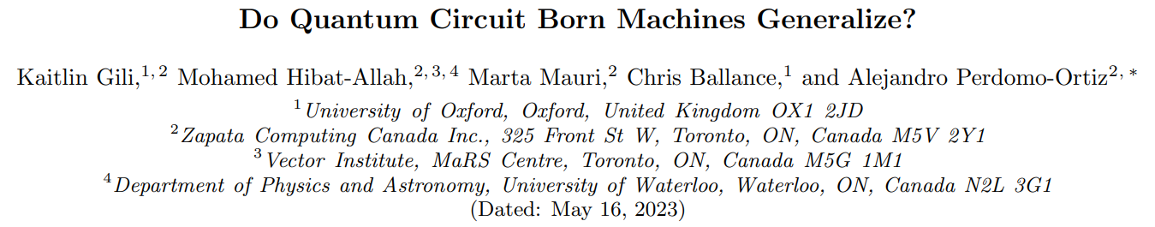
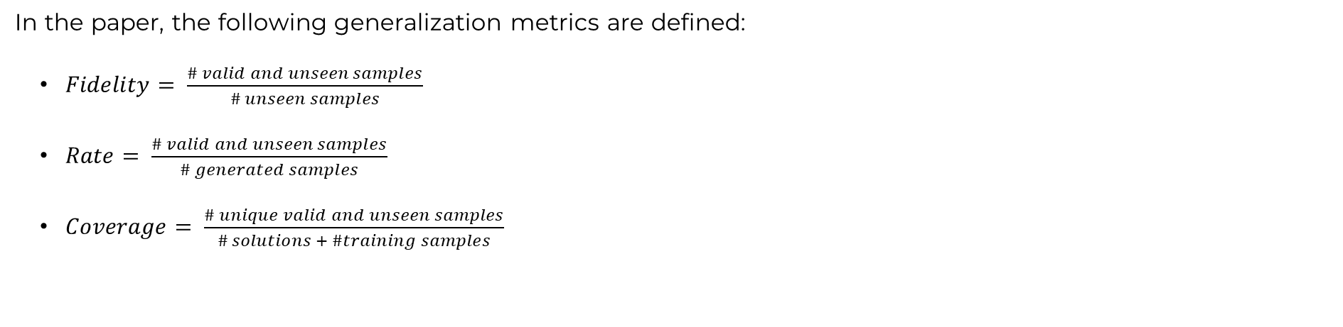
4. Results: Generalization
In the paper, the following generalization metrics are defined:
$Fidelity= \frac{\# valid and unseen samples}{\# unseen samples}$
$Rate= \frac{\# valid and unseen samples}{\# generated samples}$
$Coverage= \frac{\# unique valid and unseen samples}{\# solutions + \#training samples}$
describes how well the model can generalize to valid samples rather than produce noise; and the coverage
describes the frequency at which the model generates unseen valid samples
describes the portion of the unseen valid space the model is able to lea

Slide 27
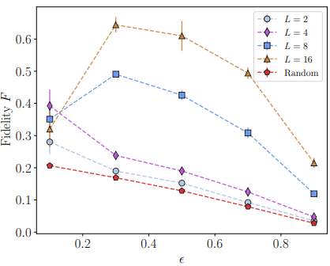
4. Results: Generalization
We remove 6 out of the 14 valid matrices from the training data, and assess the performance and generalization of QCBM:
Precision = 0.337
Fidelity = 0.006
Rate = 0.004
Coverage = 0.27
Average cost = 1.426
In the paper, using a different dataset:

Slide 28
5. Conclusions & Outlook
QCBM is able to learn/memorize the target distribution reasonably well and sample valid matrices 42% of the times
Many samples which are invalid are close to being valid, which is reflected in an average cost of 1.23
However, the generalization capabilities of QCBM for Bars and Stripes dataset is very por
Another ansatz could be implemented, aiming to improve generalization, CNOT gates topology of Chow-Liu tree (specific to dataset)
An explanation of the QCBM has to be added to the tutorial Jupyter Notebook
Create a documentation file for the QCBM class

Slide 29
Questions?

Slide 30
3
Bayesian Optimization applied to hyperparameter tuning in SQA

Slide 31
3.1
Overview of Bayesian optimization and its Applications
3.2
Description of the algorithm
3.3
Bayesian optimization applied to SQA: Results

Slide 32
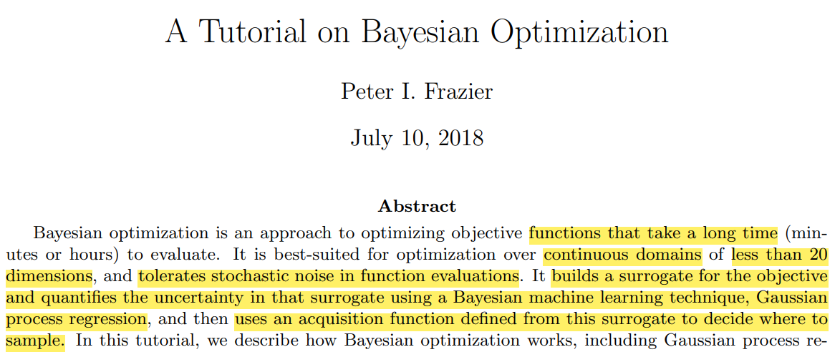
1. Overview of Bayesian optimization (BO) and its Applications

Slide 33
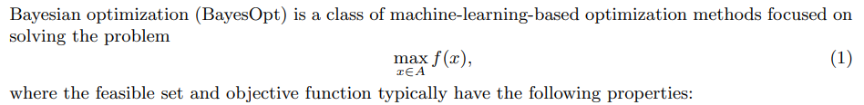
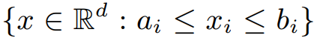
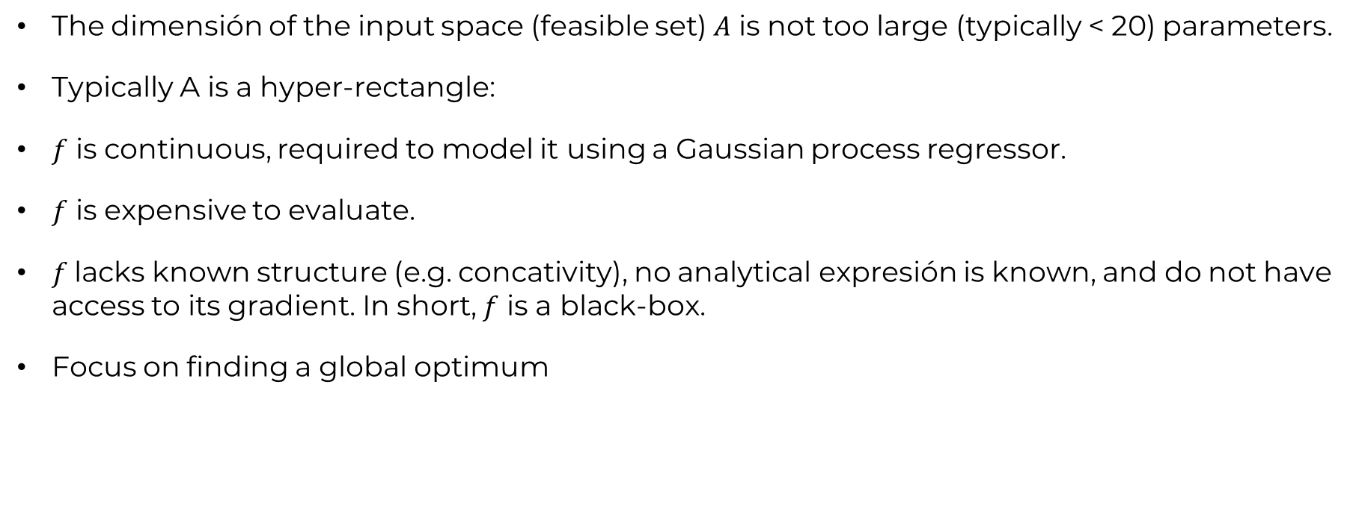
1. Overview of Bayesian optimization (BO) and its Applications
The dimensión of the input space (feasible set) $A$ is not too large (typically < 20) parameters.
Typically A is a hyper-rectangle:
$f$ is continuous, required to model it using a Gaussian process regressor.
$f$ is expensive to evaluate.
$f$lacks known structure (e.g. concativity), no analytical expresión is known, and do not have access to its gradient. In short, $f$ is a black-box.
Focus on finding a global optimum

Slide 34
1. Overview of Bayesian optimization (BO) and its Applications
Applications (already developed):
Designing engineering systems
Calibration of environmental models
Hyperparameter tuning in machine learning algorithms
Bayesian optimization distinguishes itself from other surrogate methods by using surrogates developed using Bayesian statistics, and in deciding where to evaluate the objective using a Bayesian interpretation of these surrogates.

Slide 35
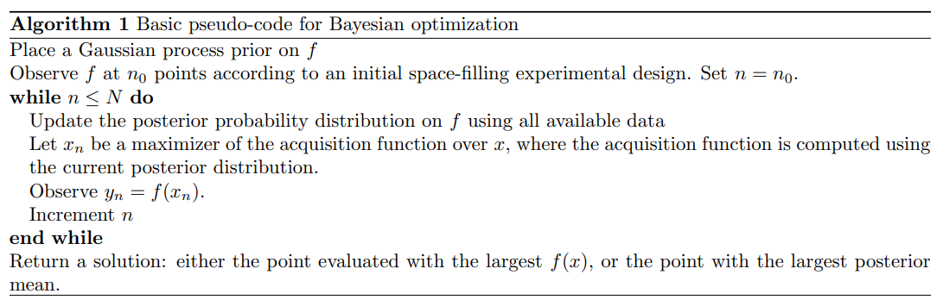
2. Description of the algorithm
BayesOpt consists of two main components: a Bayesian statistical model for modeling the objective function, and an acquisition function for deciding where to sample next.
After evaluating the objective according to an initial space-filling experimental design, often consisting of points chosen uniformly at 2 random, they are used iteratively to allocate the remainder of a budget of N function evaluations, as shown in Algorithm 1.

Slide 36
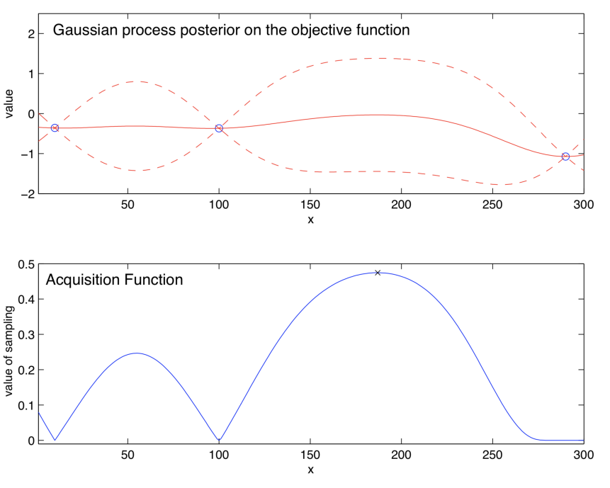
2. Description of the algorithm
1. Gaussian process regressor
2. Acquisition function

Slide 37
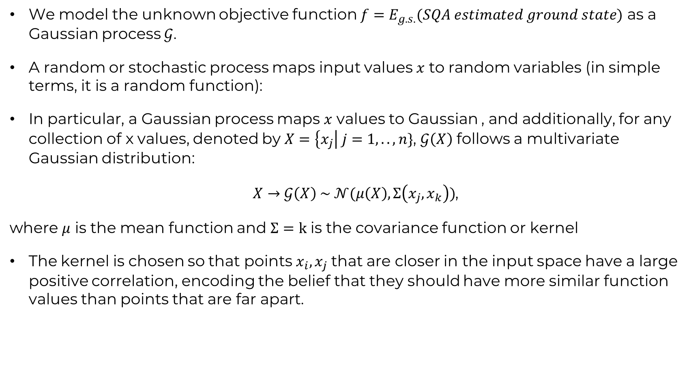
2. 1. Technical details: Gaussian process regressor
We model the unknown objective function ${f=E}_{g.s.}(SQA estimated ground state)$ as a Gaussian process $𝒢$.
A random or stochastic process maps input values $x$ to random variables (in simple terms, it is a random function):
In particular, a Gaussian process maps $x$ values to Gaussian , and additionally, for any collection of x values, denoted by $X=\left\{x_{j}\right| j=1,..,n\}$, $𝒢\left(X\right)$ follows a multivariate Gaussian distribution:
$X→𝒢\left(X\right) \sim 𝒩(μ\left(X\right),Σ\left(x_{j},x_{k}\right))$,
where $μ$ is the mean function and $Σ=k$ is the covariance function or kernel
The kernel is chosen so that points $x_{i},x_{j}$ that are closer in the input space have a large positive correlation, encoding the belief that they should have more similar function values than points that are far apart.

Slide 38
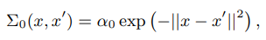
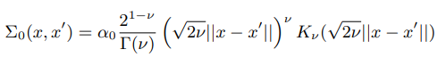
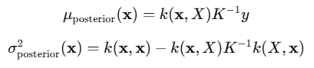
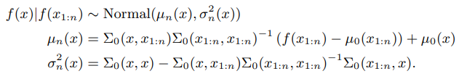
2. 1. Technical details: Gaussian process regressor
First of all, we choose a kernel function, e.g., Gaussian or Matern:
After evaluating the objective function at n random points (calling SQA with a specific graph and n combinations of hyperparameters):
We calculate the covariance matrix of the outputs K
We calculate the posterior mean and covariance with Bayes’ theorem:
For the subsequent points (suggested by the acquisition function), Bayes’ theorem yields:
Gaussian:
Matern:
Gaussian processes allows an efficient and direct update rule !

Slide 39

2. 2. Technical details

Slide 40
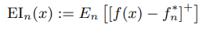
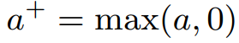



2. 2. Technical details: Acquisition function
Most commonly used: Expected improvement (EI)
, where
Using A Gaussian process, an analytical expression can be obtained by integrties by parts:
where $φ$ and $Φ$ denote the PDF and CDF of the standard normal distribution, respectively
This optimization depends relies on the surrogate model, so gradient-based optimizers can be used
Next point where the objective function is evaluated:
*Jones, D. R., Schonlau, M., and Welch, W. J. (1998). Efficient global optimization of expensive black-box functions. Journal of Global Optimization, 13(4):455–492.

Slide 41

3.1 Application to hyperparameter tuning of SQA: Set-up
SQA parameters to optimize:
x = (beta, annealing_time, gamma_0, n_trotters)

Slide 42



3.2 Application to hyperparameter tuning of SQA: Results
Graph of 40 qubits given by Daniel
Minimum energy found $=−$32.57
Optimization took around 7 hours
The energy does not decrease with the iteration number
The energy landscape seems very rugged, which is compatible with Daniel’s analyses
BO seems to be doing simply a random search
Can it be done better?

Slide 43


3.2 Application to hyperparameter tuning of SQA: Results

Slide 44


3.2 Application to hyperparameter tuning of SQA: Results

Slide 45

3.2 Application to hyperparameter tuning of SQA: Results

Slide 46


3.2 Application to hyperparameter tuning of SQA: Results

Slide 47


3.2 Application to hyperparameter tuning of SQA: Results

Slide 48
4. Conclusions & outlook
Although Bayesian Optimization did not show convergence, the lowest energy found was good, comparing to Daniel’s analysis.
I have to make sure that the implementation is 100% correct, by applying Bayesian optimization to previously analysed objective functions.
Make a further comparison study of the performance of Bayesian optimization compared to Daniel’s grid search and heuristics.
How noisy is SQA?
Code available in: https://github.com/cesar-hernando/QML/tree/main/SQA-BO

Slide 49
Questions?

Slide 50
Thank you!
For more information, contact:
cesar.hernando22@gmail.com
cesar.Hernando@atos.net
chernandodelaf@tudelft.nl

